Slide 1
CAR Review, 1Q, 2013
V 1.0

Slide 2
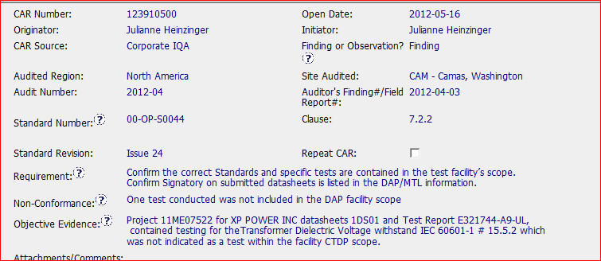
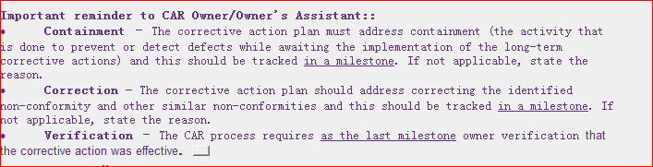
CAR 123910500
Good Information for CAR owner

Slide 3
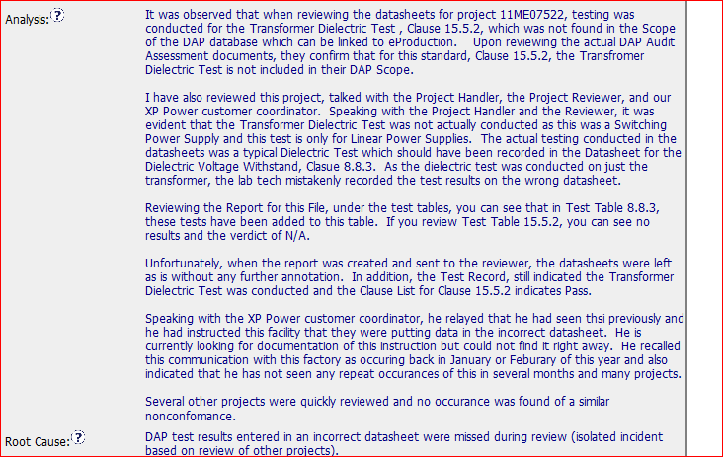
Good Example - CAR 123910500
Identifying the stakeholder
Analysis of scope

Slide 4
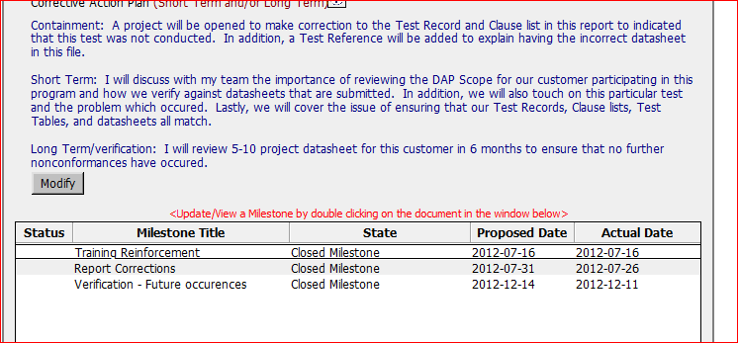
Good Example - CAR 123910500
Having action to prevent it from reoccurrence
Having containment and Verification milestones

Slide 5
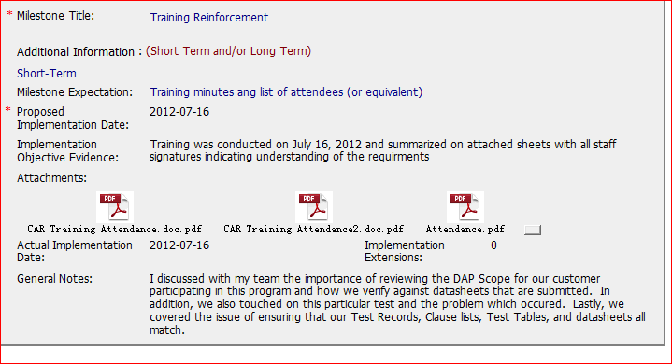
Good Example - CAR 123910500
Including the training content and attendance sheets

Slide 6
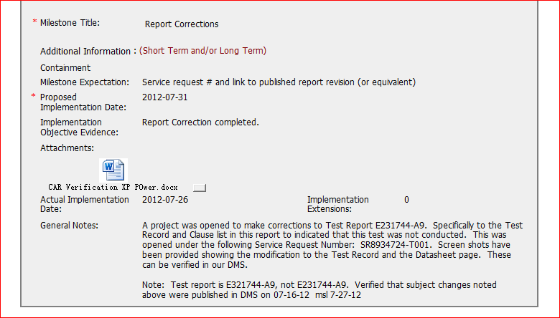
Good Example - CAR 123910500
Having the confirmation information for DMS

Slide 7
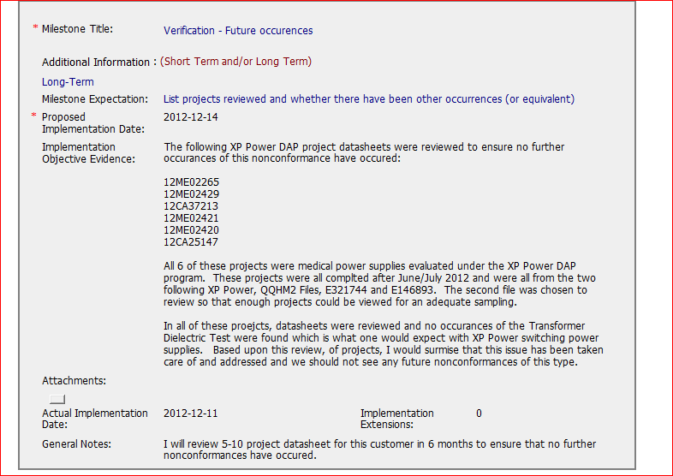
Good Example - CAR 123910500
Having project listed and statement regarding to the verification results

